Slide 1
DAX Functions in Power BI
Dr. Rakhee Chhibber

Slide 2
Data Analysis Expressions (DAX)
Data Analysis Expressions (DAX) is a useful formula and query language used to perform advanced calculations on tabular data models in Power BI and Power Pivot. It enables dynamic, context-aware analysis that goes beyond traditional spreadsheet formulas.
  Used to create custom measures, calculated columns and tables
  Supports complex calculations with row and filter context
  Provides advanced functions not available in standard Excel formulas

Slide 3
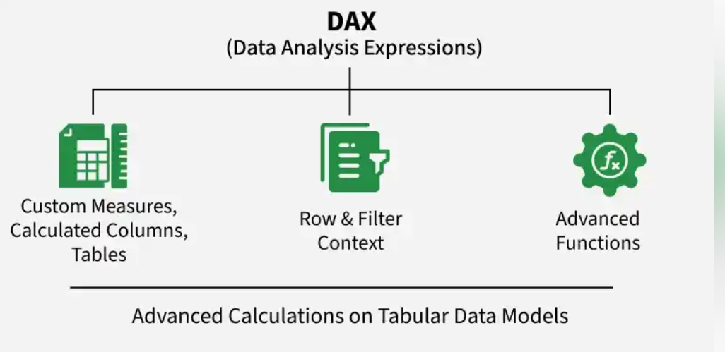

Slide 4
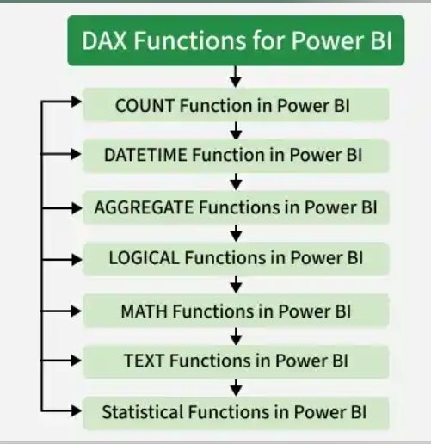

Slide 5
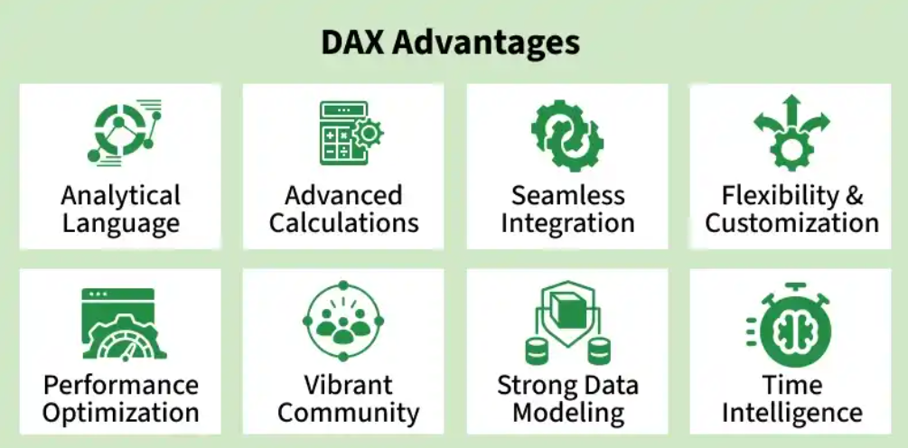

Slide 6
Understanding DAX Fundamentals
DAX uses a formula syntax similar to Excel but extends it with advanced functions designed specifically for tabular data models in Power BI. It allows users to create measures, calculated columns and calculated tables to perform dynamic and context-aware calculations.
There are two primary data types in Power BI DAX functions:
Numeric: Numeric data types include decimals, currency values, integers, etc.
Non-numeric: It consists of strings, binary objects, etc.

Slide 7
DAX Ca lculation Type
Calculated Tables - These calculations will add an additional table to the report based on a formula.
Calculated Columns - These calculations will add an additional column to a table based on a formula. These columns are treated like any other field in the table.
Measures - These calculations will add a summary or aggregated measure to a table based on a formula.

Slide 8
Creating Measures for Advanced Calculations
Measures are a core component of DAX used for calculations on aggregated data
They are evaluated at query time not stored in the data model
Measures respond dynamically to filters, slicers and report context
Commonly used measures include SUM, AVERAGE and COUNT
DAX supports both implicit and explicit measures
Using correct data types is essential for accurate measure calculations

Slide 9
Working with Calculated Columns
Calculated columns create new fields by deriving values from existing columns
Values are calculated row by row and stored in the data model
Useful for categorization, flags and static calculations
Best suited for scenarios where results are not dependent on filters or slicers

Slide 10
Time Intelligence
DAX includes time intelligence functions for analyzing trends in time-based data
Functions like TOTALYTD, SAMEPERIODLASTYEAR and DATEADD enable period comparisons
Used for year-to-date, month-over-month and year-over-year analysis
Helps generate meaningful insights from time series data

Slide 11
Filtering and Aggregating Data
DAX provides functions to filter and aggregate data based on specific conditions
FILTER applies row-level conditions to a table
CALCULATE modifies filter context to perform dynamic calculations
SUMMARIZE creates custom aggregations for deeper analysis

Slide 12
Optimization Techniques
Writing efficient DAX is crucial for fast and responsive Power BI reports
Use variables (VAR) to simplify calculations and avoid repeated computations
Minimize complex or nested calculations to reduce processing time
Understand query behavior and filter context to optimize performance

Slide 13

DAX Functions for Power BI
Functions in DAX perform various tasks such as data manipulation, aggregation, filtering, time intelligence and custom calculations. They allow users to transform, analyze and derive insights from data within Microsoft Power BI, Power Pivot and SQL Server Analysis Services. There are various functions, some are given below:

Slide 14
1. COUNT function in Power BI
COUNT: It returns the total number of items in the column.
Syntax: COUNT(<column name>)
COUNTROWS: It returns the number of rows in the table.
Syntax: COUNTROWS(<table name>)
DISTINCTCOUNT: It returns the number of distinct values in the values column.
Syntax: DISTINCTCOUNT(<column name>)
COUNTA: It counts the number of items in a column, that is not empty i.e. occupied.
Syntax: COUNTA(<column name>)
COUNTBLANK: It counts blank cells in a single column.
Syntax: COUNTBLANK(<column nam>)

Slide 15
2. DATETIME function in Power BI
DATE: Returns a date value from year, month and day.
Syntax: DATE(<year>, <month>, <day>)
HOUR: Returns the hour as a number from 0 to 23.
Syntax: HOUR(<datetime>)
TODAY: It returns today's date.
Syntax: TODAY()
WEEKDAY: It returns values between 1-7 where according to the day number in a week where 1 refers to Sunday and 7 is Saturday.
Syntax: WEEKDAY(<date>, <return_type>)
NOW: It returns the current date and time in datetime format.
Syntax: NOW()

Slide 16
3. AGGREGATE Functions in Power BI
MIN: Finds the minimum value in a given column or between two expressions.
Syntax: MIN(<column>) or MIN(<exp1>,<exp2>)
MAX: Returns the maximum value in a given column or between two expressions.
Syntax: MAX(<column>) or MAX(<exp1>,<exp2>)
SUM: The formula adds the values in a column to produce a total.
Syntax: SUM(Sales[Amount])
AVERAGE: It takes columns of data and returns the average.
Syntax: AVERAGE(Sales[Amount])
MINX: Calculates the minimum value after evaluating each row expression in a table.
Syntax: MINX(<table>, <expression>)

Slide 17
4. LOGICAL Functions in Power BI
AND: Combines 2 expressions logically.
Syntax: AND(<logical1>,<logical2>)
OR: This function performs the logical disjunction on 2 expressions.
Syntax: OR(<logical1>,<logical2>)
NOT: Negates the given expression logically.
Syntax: NOT(<logic>)
IF: It checks IF a criterion is true and returns one value if it is and another value if it is not.
Syntax: IF(<logical_test>,<value_if_true>, value_if_false)

Slide 18
5. MATH Functions in Power BI
ABS: Returns the absolute value.
Syntax: ABS([number])
FACT: Returns the factorial of the number.
Syntax: FACT([number])
EXP: Calculates the exponential value of a number.
Syntax: EXP([Number])
ROUND: Rounds a number to a specified number of decimal places.
Syntax: ROUND([Number], [NumDigitsAfterDecimal])
POWER: Raises a number to a specified power.
Syntax: POWER([Number], [Power])
LOG: Calculates the logarithm of a number to a specified base.
Syntax: LOG([Number], [Base])
SQRT: Calculates the square root of a number.
Syntax: SQRT([Number])
MOD: Returns the remainder of a division operation.
Syntax: MOD([Dividend], [Divisor])
SIN, COS, TAN: Calculates the trigonometric sine, cosine and tangent of an angle, respectively.
Syntax: SIN([Angle]), COS([Angle]), TAN([Angle])

Slide 19
6. TEXT Functions in Power BI
CONCATENATE: Joins two strings together.
Syntax : CONCATENATE(<text_1>,<text_2>)
FIXED: Rounds off numbers to a given decimal.
Syntax: FIXED([Number], [NumDigitsAfterDecimal], [IncludeLeadingZeroes])
REPLACE: Replace the characters with part of a string.
Syntax: REPLACE(<old_text>, <start_num>, <num_chars>, <new_text>)
UPPER: Converts a text string to all uppercase letters.
Syntax: UPPER(<text>)
LOWER: Converts a text string to all lowercase letters.
Syntax: LOWER(<text>)
SEARCH: Returns the number of the character at which a searched character or text string is first appeared.
Syntax: SEARCH(<find_text>, <within_text>[, [<start_num>][, <NotFoundValue>]])

Slide 20
7. Statistical Functions in Power Bi
MEDIAN: Returns the median value in a column.
Syntax: MEDIAN([Column])
MODE: Returns the mode (most frequently occurring value) in a column.
Syntax: MODE([Column])
AVERAGE: Calculates the average of a column of numeric values.
Syntax: AVERAGE([Column])
STDEV.P: Calculates the population standard deviation of a column.
Syntax: STDEV.P([Column])
STDEV.S: Calculates the sample standard deviation of a column.
Syntax: STDEV.S([Column])
VAR.P: Calculates the population variance of a column. Example:
Syntax: VAR.P(Column)

Slide 21
Calculate, Sum, sumx and calculatetable functions

Slide 22
1. CALCULATE
The CALCULATE function is among the strongest DAX formula. It evaluates an expression in the context of a changed filter.
CALCULATE(<expression>, <filter1>, <filter2>...)
Electronics Sales = CALCULATE(SUM(Sales[Quantity]), Products[Category] = "Electronics")

Slide 23
2. SUM and SUMX
The SUM function is straightforward, summing up all values in a column. SUMX, on the other hand, is an iterator function that sums up the results of an expression evaluated for each row in a table.
SUM(<column>)
SUMX(<table>, <expression>)
Total Quantity Sold = SUM(Sales[Quantity])
Total Profit = SUMX(Sales, Sales[Quantity] * (Sales[UnitPrice] - RELATED(Products[Cost])))

Slide 24
3. CALCULATETABLE
CALCULATETABLE evaluates a table expression in a modified filter context, similar to how CALCULATE works with scalar expressions.
CALCULATETABLE(<table_expression>, <filter1>, <filter2>,...)
Electronics_Sales =CALCULATETABLE(Sales,Product[Category] = "Electronics")

Slide 25
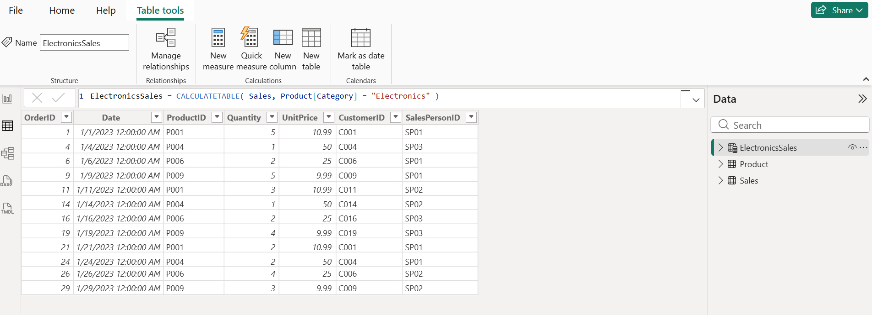

Slide 26
Examples of Calculatetable
Example 2 — High Quantity Orders
Create a table where Quantity > 3
HighQuantitySales =
CALCULATETABLE(
Sales,
Sales[Quantity] > 3
)
Example 3 — Multiple Filters
Suppose: Category = Electronics and Quantity > 2
FilteredSales =
CALCULATETABLE(
Sales,
Product[Category] = "Electronics",
Sales[Quantity] > 2
)

Slide 27
Examples of Calculatetable
Example 4 — Sales After Specific Date
RecentSales =
CALCULATETABLE(
Sales,
Sales[Date] >= DATE(2023,1,5)
)
Example 5 — Using FILTER Inside CALCULATETABLE
ExpensiveProductSales =
CALCULATETABLE(
Sales,
FILTER(
Product,
Product[Cost] > 20
)
)

Slide 28
Total Sales Rank =
RANKX(
ALL(Sales[SalesPersonID]),
CALCULATE(
SUMX(
Sales,
Sales[Quantity] * Sales[UnitPrice]
)
)
)

Slide 29
RANKX
RANKX ranks items in a table based on an expression. It helps create rankings within a data set. his process will help you:
  Create Total Sales
  Create Rank using RANKX
  Add visuals
  Display ranking on dashboard
Rankx(<table>,<expression>,<value>(optional),<order>(optional),<ties>(optional))
RANKX(
ALL(Sales[SalesPersonID]),
CALCULATE(SUM(Sales[Quantity] * Sales[UnitPrice]))
)

Slide 30
steps
Create relationships
Create Total Sales Column
TotalSales = Sales[Quantity] * Sales[UnitPrice]
Create Total Sales Measure
TotalSales = Sales[Quantity] * Sales[UnitPrice]
Create RANKX Measure
Product Rank = RANKX( ALL(Product[ProductName]), CALCULATE(SUM(Sales[TotalSales])), ,DESC,DENSE)
Add Table Visual for electronics table
Add Fields – product name, total sales, rank

Slide 31
VLookUP in Power BI
In Power BI, there is no direct Excel VLOOKUP function. Instead, Power BI uses:
Relationships
RELATED()
LOOKUPVALUE()
Merge Queries (Power Query)

Slide 32
Best Equivalent of VLOOKUP in Power BI
Excel | Power BI Equivalent
VLOOKUP | RELATED
Advanced VLOOKUP | LOOKUPVALUE
Database Join | Merge Queries

Slide 33
SCENARIO USING FILE
1. Sales Table having Fields ProductID, Quantity, UnitPrice
2. Product Table having fields ProductID, ProductName, Category
Problem statement – I want to fetch
ProductName
Category
inside Sales table.
This is exactly like Excel VLOOKUP.

Slide 34
METHOD 1 — Using RELATED()
STEP 1 — Load Excel File
STEP 2 — Create Relationship
STEP 3 — Use RELATED Function
  Goto data view select sales table
  Create a new column product name and give the following DAX function
    Product Name = RELATED(Product[ProductName])
  Create a new column and add new column and the following DAX function
    Category =RELATED(Product[Category])
Setting | Value
Cardinality | Many to One
Cross Filter | Single

Slide 35
METHOD 2 — Using LOOKUPVALUE() – Advance Lookup
Use this when:
  No relationship exists
  Multiple conditions needed
  Advanced lookup required

Slide 36
Steps
1. Create Product Name Column and give DAX function
Product Name = LOOKUPVALUE(Product[ProductName], Product[ProductID], Sales[ProductID] )
2. Create Category Column and give DAX Function
Category = LOOKUPVALUE(Product[Category], Product[ProductID], Sales[ProductID] )
Part | Meaning
Product[ProductName] | Return column
Product[ProductID] | Search column
Sales[ProductID] | Matching value

Slide 37
Thank you

